Slide 1

Beyond Automated Testing
By: Andrew McNicol
& Zack Meyers

Slide 2



Agenda
~$ whoami
Overview
How to Go Beyond a Scan
Testing Methodologies
Soft Skills
Planning
Organization
Reconnaissance
Mapping
Automated Testing
Manual Testing
Examples
Useful Resources
Reporting
Remediation Support
Useful Trainings and Links

Slide 3
~$ whoami
Andrew McNicol (@primalsec)
Zack Meyers (@b3armunch)
We are Security Geeks
Red Team @BreakPoint Labs (@0xcc_labs)
Bloggers/Podcasters @Primal Security (@primalsec)
Certification Junkies (OSCE, OSCP, GWAPT, GPEN etc.)
Python, CTFs, Learning, long walks on the beach (@AnnapolisSec)

Slide 4
Overview
Goal: To share our experiences with external security assessments
Motivation: Mostly frustration… How many of you have heard this?
  Is the scan done? Can you scan us?
Automated Testing: Running a vulnerability scanner
Manual Testing: Everything else you do beyond the scope of the scan
According to a recent DHS report, 67% of high impact vulnerabilities required manual testing to enumerate

Slide 5

How to Go Beyond a Scan
Mindset: Fail 1000s of times and Continue Trying
Recon + Mapping: Find Systems + Content Others Have Missed
Automated Testing: Run the appropriate tool for the job
Manual Testing:
  Identify, Understand, and Fuzz all Areas of Input
  Research all Version Specific Vulnerabilities
  Combine Findings, Remove False Positives, and Abuse Features
Reporting: Highlight Business Impact

Slide 6
Testing Methodologies
A solid methodology helps from a technical and business perspective
      You do not need to marry a methodology during your engagements
      Create checklists and templates to guide assessment process
Several great methodologies exist:
        Pentesting Execution Standard (PTES)
        OWASP Testing Guide (OTG) 4.0
        Web Application Hackers Handbook Task Checklist
    Good methodologies should include Automated and Manual testing

Slide 7
Our Methodology (High Level)
Planning and Scoping
Reconnaissance
Mapping
Automated Testing
Manual Testing
Reporting
Remediation Support

Slide 8

Soft Skills
Be confident and know that you will fail 1000s of times before you succeed…

Slide 9
Planning
Understanding your customers Goals
Establish the scope “What”
Establish the Rules of Engagement (ROE) “How”
Setup communication channels and timeframe “Who and When”
Do not get caught up in terms:
  “Pentest” means different things to different people
Figure out what is most important to the business
  Confidentiality, Availability, or Integrity?

Slide 10
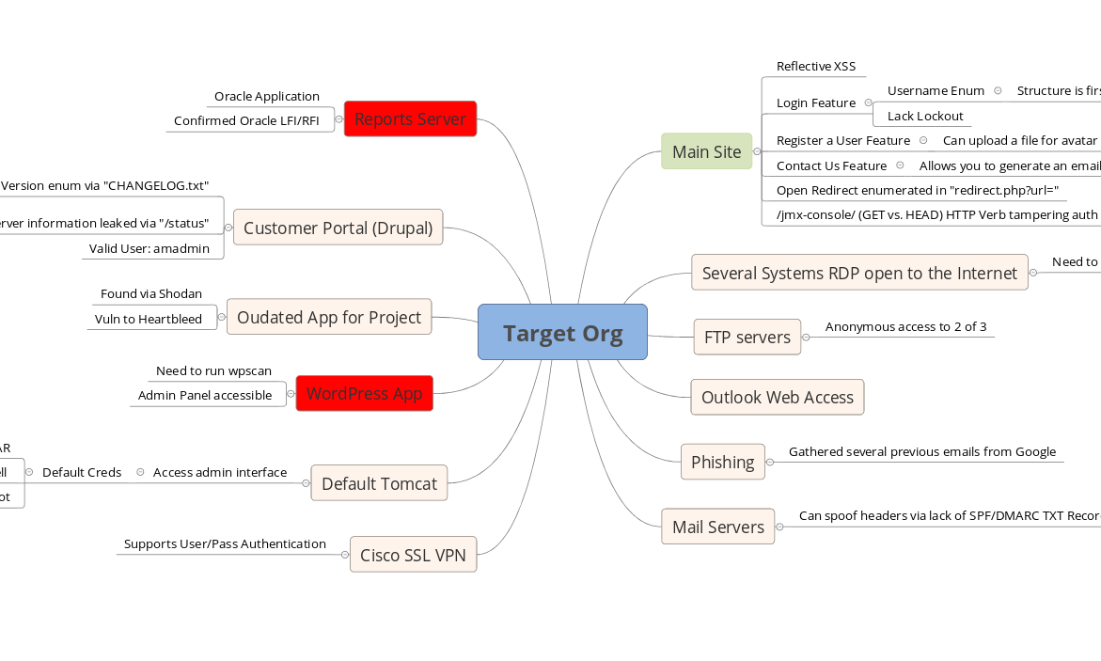
Organization: Mind Map

Slide 11

Reconnaissance

Slide 12
Reconnaissance
Goal: Given a company name, how can you map their footprint?
IP/Domain Research (Dig, whois, Google, etc.)
System Enumeration (Shodan, Censys.io, Masscan, Nmap)
Subdomain Enumeration (Google, Recon-ng, crt.sh, fierce.pl, etc.)
Tech Stack Enumeration (Whatweb, Wappalyzer, EyeWitness)
OSINT (emails, names, mergers, acquisitions, etc.)

Slide 13
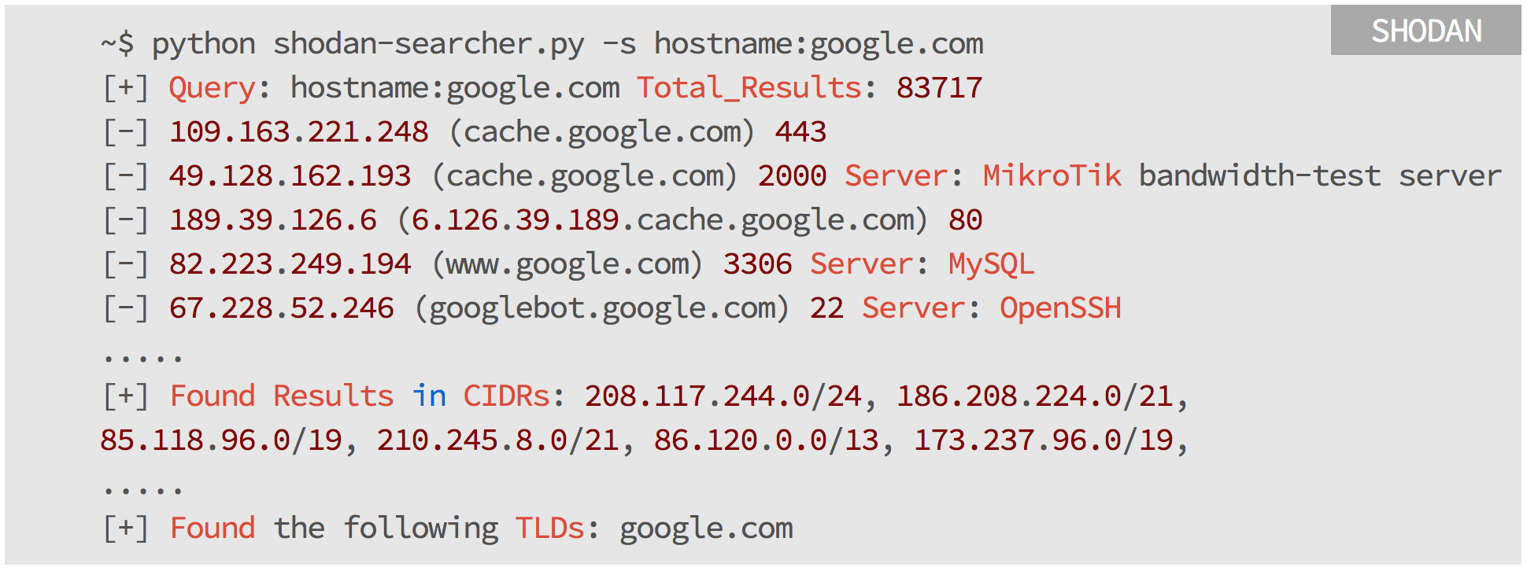
System Enumeration
Shodan + Censys.io (3rd Party Gathered)
Masscan -> Nmap (Active Probing)

Slide 14
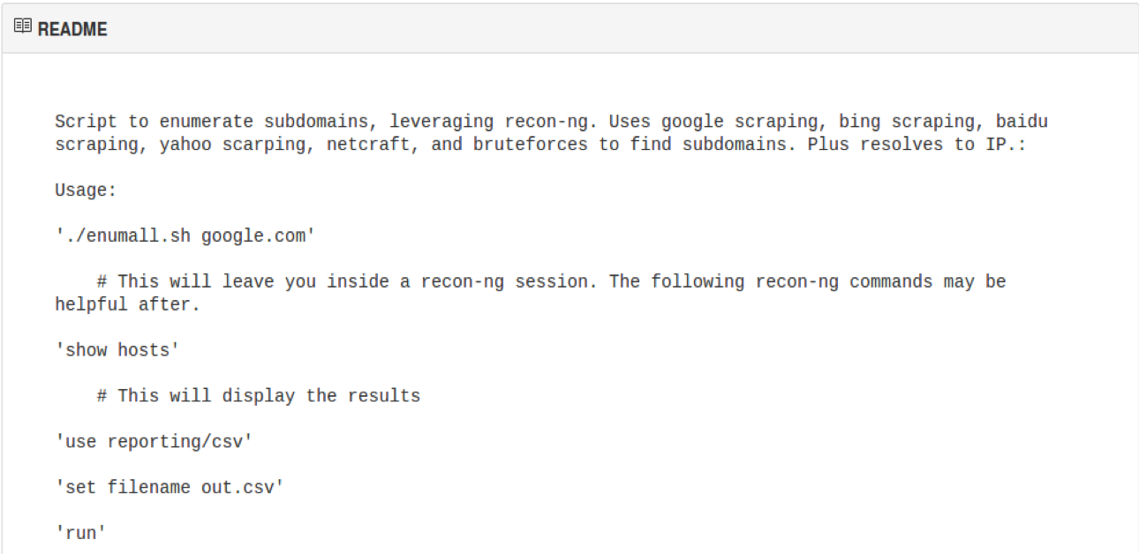
Subdomain Enumeration
Google, Shodan, crt.sh, Recon-ng, fierce.pl
Jason Haddix wrote a script: enumall.sh for Recon-ng

Slide 15
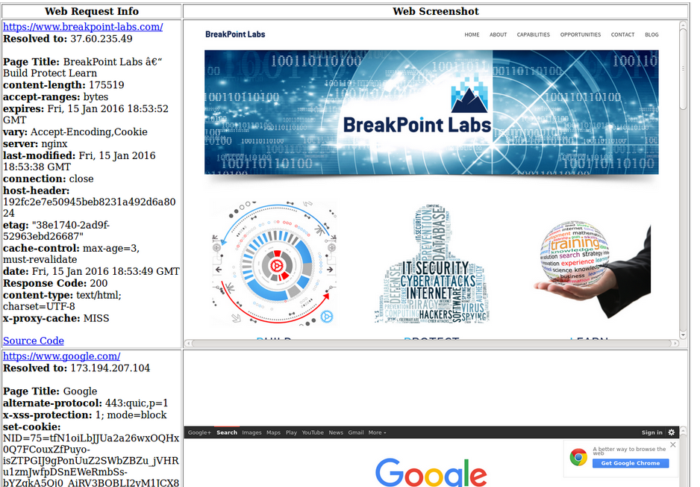
Tech Stack Enumeration
Whatweb, Wappalyzer, EyeWitness

Slide 16

OSINT
Customer Already Compromised?
      Usernames, YouTube, Social Media, etc.
      Posting on stack overflow, GitHub, Pastebin?
      Can you find source code online?

Slide 17
Mapping

Slide 18
Map Your App
Mapping your App is key before kicking off automated testing
Spider: enumerates linked content
Brute Force techniques to enumerate unlinked content
      Do not judge a system by its IP:
        1 IP could have several domains living on it
        http://ip-addr/ may get you very little and http://ip-addr/unlinked-dir/ may store the application
        http://ip-addr/ vs. http://domain-name/ (Virtual Hosting?)

Slide 19
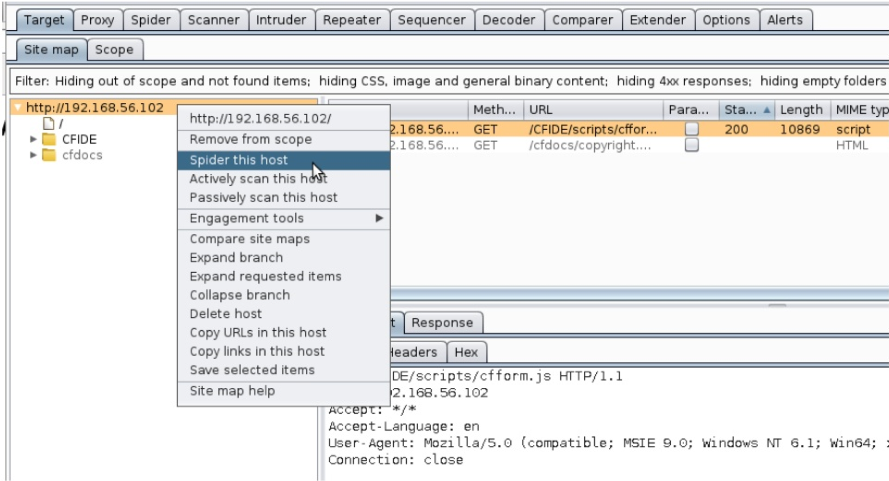
Spidering

Slide 20

Unlinked Content Enumeration
Use Burps Intruder and it’s methods (Sniper, Cluster Bomb, etc.)
Use Burp Pros Discover Content feature to expand your Site Map
Use Commonly known lists from tools like Dirbuster
Web Services (?wsdl, wsdler, SoapUI, etc.)
SecLists: collection of content (Passwords, Resources, etc.)
Source: https://github.com/danielmiessler/SecLists

Slide 21
Automated Testing

Slide 22

Automated Testing
This is where you’d actually click the “scan” button #SavesTime
Run the right tool for the job!
Few things to keep in mind about Automated Testing:
  Can miss stuff
  Can break stuff
  Can take a long time
  Can have false positives

Slide 23
Manual Testing

Slide 24
Manual Testing: Questions
For us manual testing is about four (4) main things:
Identify all areas of user input (Injection Points) and fuzz
Identify all features and abuse them like an attacker
Find the systems and content that others have missed
Continue to ask yourself “What happens if I try this?”

Slide 25
Manual Testing: Questions (Cont.)
Is your input being presented on the screen? -> XSS
Is your input calling on stored data? -> SQLi
Does input generate an action to an external service? -> SSRF
Does your input call on a local or remote file? -> File Inclusion
Does your input end up on the file system? -> File Upload
Does your input cause another page to load? -> Redirect Vulns
Can we enumerate email addresses? -> Phishing Targets

Slide 26
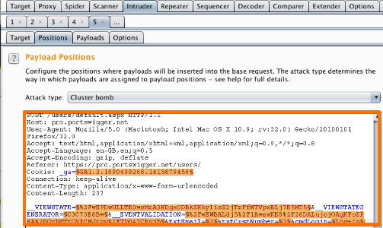
Custom Input Fuzzing
FuzzDB, Raft Lists, and SecLists provide great lists for fuzzing
Understand how your input is being used to target fuzzing (XSS, SQLi, LFI, etc.)
Burp Suite Pro’s Intruder is our go to tool for web application fuzzing

Slide 27

Manual Testing Examples
We plan to walk through a few examples to demonstrate some manual testing techniques

Slide 28
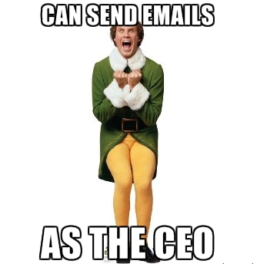
Ex 1: Feature Abuse
Contact Us and Feedback forms are commonly vulnerable to SMTP Injection
How excited would you be?

Slide 29
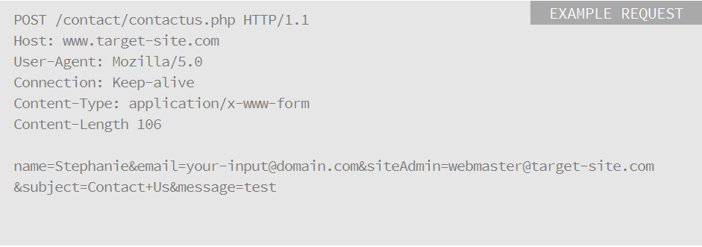
Ex 1: Feature Abuse (Cont.)
We can control the ‘siteAdmin’ & ‘subject’ parameters

Slide 30

Ex 2: Combine Several Findings
Very common finding with web application testing
Combines several vulnerabilities that automated tools may find but don’t put together or exploit:
    Username enumeration (Low) +
    Lack of Automation Controls (Low) +
    Lack of Password Complexity Reqs (Low) =
    - Account Compromise (Critical)

Slide 31
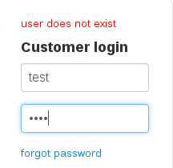
Ex 2: Username Enumeration
Password Reset Feature “Email address not found”
Login Error Message “Invalid Username”
Timing for login Attempts: Valid = 0.4 secs Invalid = 15 secs
User Registration “Username already exists”
Various error messages, and HTML source
Contact Us Features “Which Admin do you want to contact?”
Google Hacking and OSINT
Document Metadata
Sometimes the application tells you

Slide 32
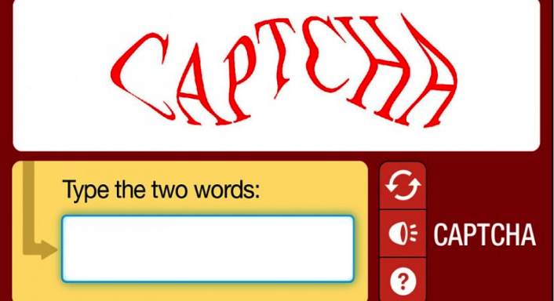
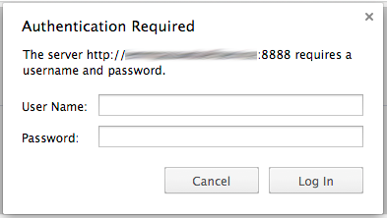
Ex 2: Automation Controls
Pull the auth request up in Burp’s Repeater and try it a few times
No sign of automation controls? -> Burp Intruder
- No account lockout
- Non-existent or Weak CAPTCHA
- Main login is strong, but others? (Mobile Interface, API, etc.)

Slide 33
Ex 2: Weak Passwords
We as humans are bad at passwords…here are some tricks:
    Password the same as username
    Variations of “password”: “p@ssw0rd”…
    Month+Year, Season+Year: winter2015…
    Company Name + year
    - Keyboard Walks – PW Generator: “!QAZ2wsx”
  Lots of wordlists out there, consider making a targeted wordlist using CeWL
  Research the targeted user’s interests and build lists around those interests

Slide 34
Ex 3: Proxy -> FW Bypass
Let’s say you stumble upon a resource called ‘proxy.ashx’
You append a “?” to the end with URL to follow (proxy.ashx?https://google.com)
This resource then loaded Google’s HTML content while remaining at our target domain… so what should be do with our open redirect?
Spear Phishing Users: By appending a malicious link to the resource we could distribute malware to unsuspecting victims
Firewall Bypass and Scanning: The application can be used to make arbitrary TCP connections to any system(s) (Internal and External). We could potentially bypass firewall restrictions to access other systems internal to their network

Slide 35
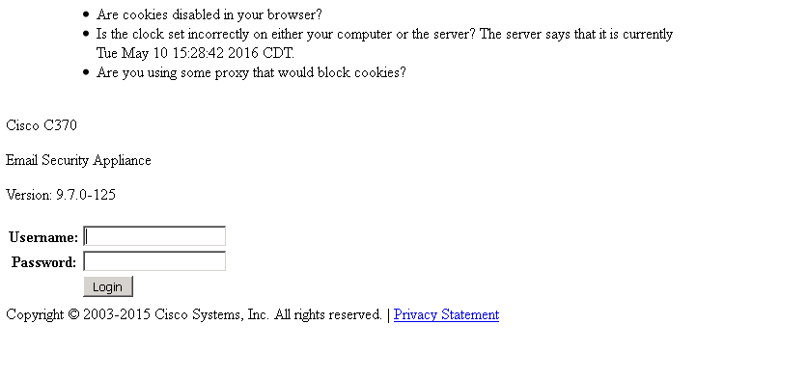
Ex 3: Proxy -> FW Bypass (Cont.)
We leveraged a quick Python script to automate this Firewall Bypass task of identifying and making connections to system on the internal network
- /proxy.ashx?http://192.168.1.200 -> 200 OK (Lets Take a Look!)

Slide 36
Ex 4: File Inclusion to Shell
File Inclusion vulns can lead to code execution “php include()”
Sometimes they are limited to just file inclusion “php echo()”
LFIs normally require you to get your input on disk then include the affected resource (log poisoning)
RFIs are normally easier to exploit as you can point them to an external resource containing your code

Slide 37
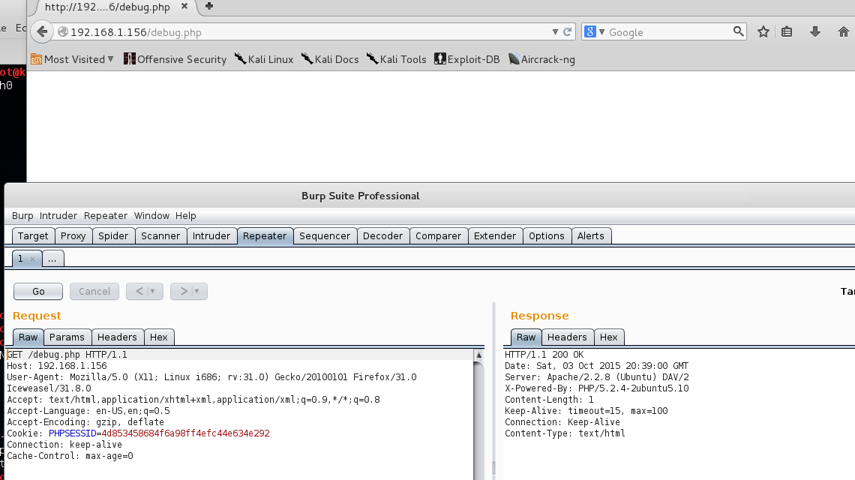
Ex 4: File Inclusion to RCE: Step 1
Unlinked resource “debug.php”- HTTP 200 OK and blank screen

Slide 38
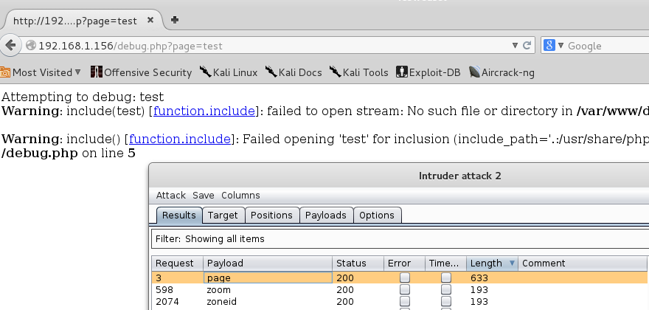
Ex 4: File Inclusion to RCE: Step 2
Parameters are fuzzed to enumerate inputs. "page=test" gives back a different response "Failed opening 'test' for inclusion”

Slide 39
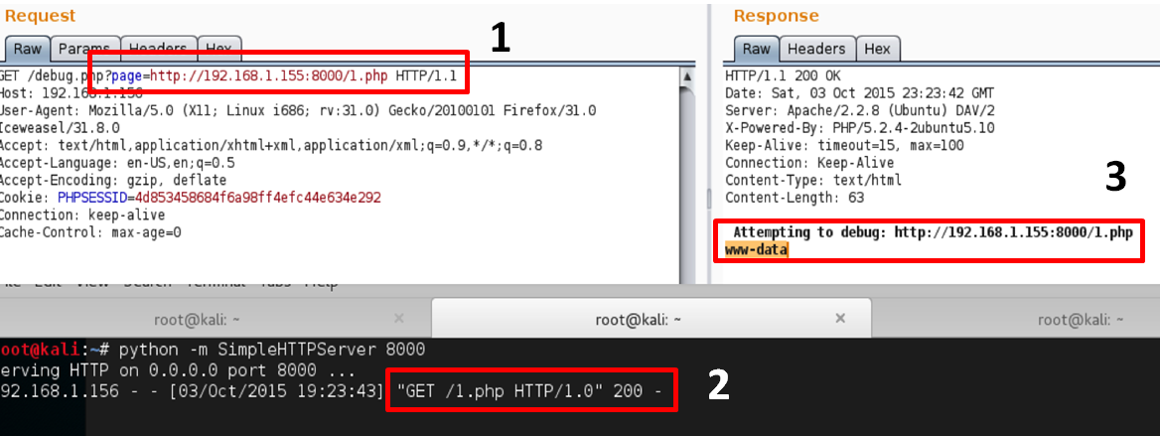
Ex 4: File Inclusion to RCE: Step 3
Attempt to execute code: 1.php = <?php system(‘id’);?>

Slide 40
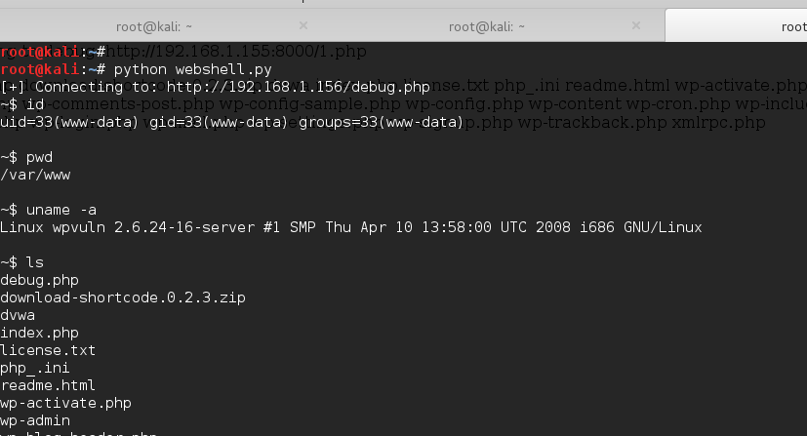
Ex 4: File Inclusion to RCE: Step 4
IN REAL LIFE: The web service was running as SYSTEM!

Slide 41
Ex 5: Email Spoofing Overview
The Perception:
  People often think SPAM filters and their own wit will allow them to never be tricked into opening a malicious email or an attachment.
The Reality:
  Emails can be spoofed often easily due to a lack of several key defenses not being put into place (SPF, DKIM, DMARC) for Mail servers.
The Statistics:
  According to the recent Verizon 2016 DBIR report “In roughly 636,000 sanctioned phishing emails, we captured whether the email was reported. Approximately 3% of targeted individuals alerted management of a possible phishing email.”

Slide 42
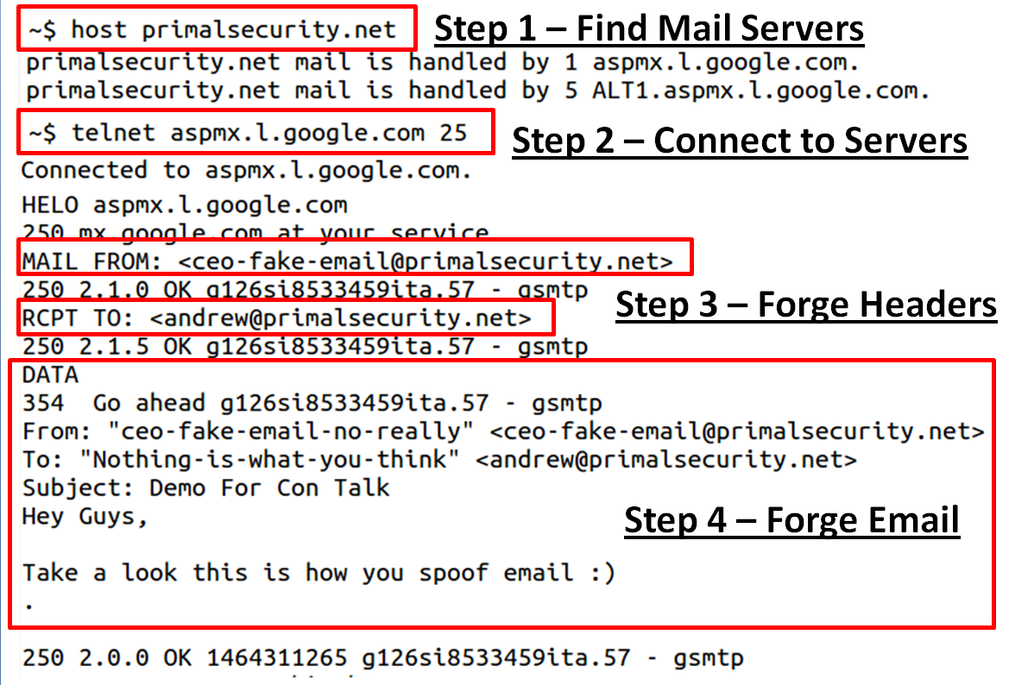
Ex 5: Email Spoofing (Cont.)

Slide 43
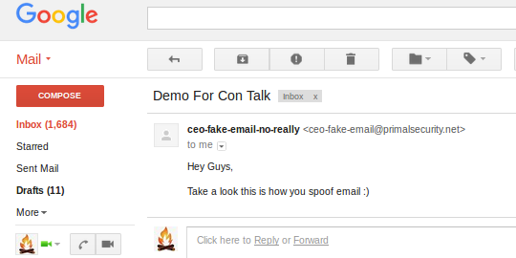
Ex 5: Email Spoofing (Cont.)
Here is what the email looks like:

Slide 44
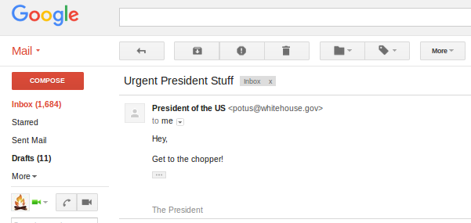
Ex 5: Email Spoofing (Cont.)
It does not have to be from the same domain either:

Slide 45
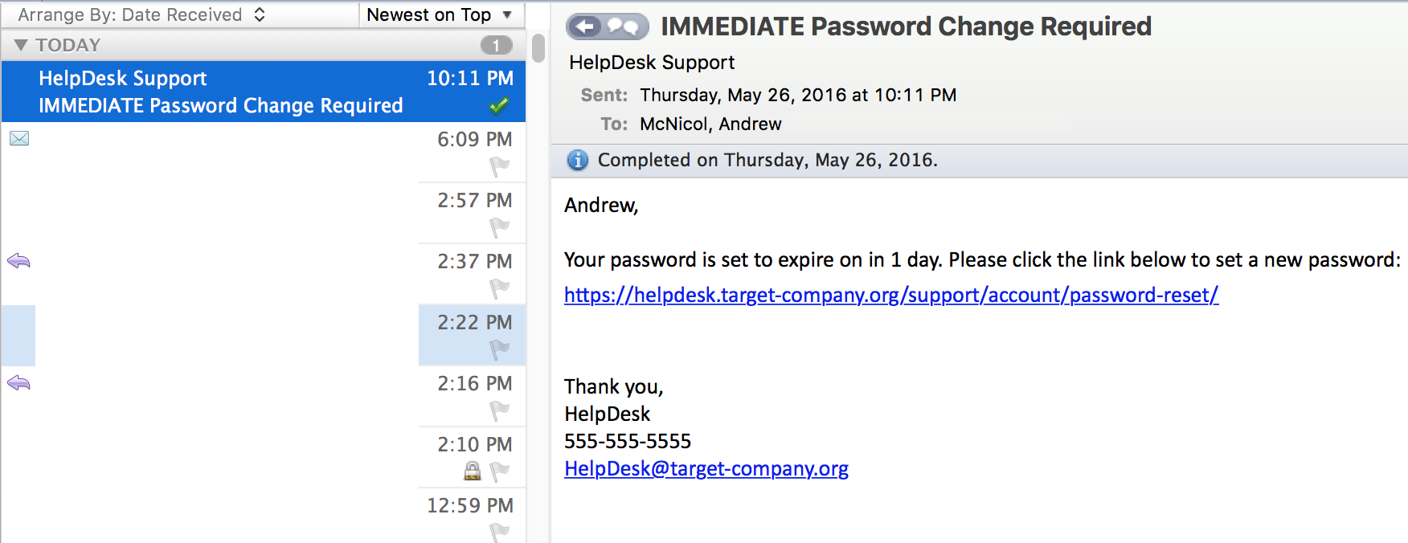
Ex 5: Email Spoofing (Cont.)
Outlook client – you can model the name of the target orgs Help Desk. Email below is sent from a Gmail account:

Slide 46
Ex 5: Email Spoofing (Cont.)
Google Apps for Work – Has little security setup and without SPF/DKIM DNS TXT records you can essentially use their domain to phish/send email
The previous email examples abused Google Apps for Work to spoof emails – very reliable technique
Solution? Configure SPF/DKIM/DMARC TXT records with your provider
Very few people configure these in our experience

Slide 47
Reporting

Slide 48
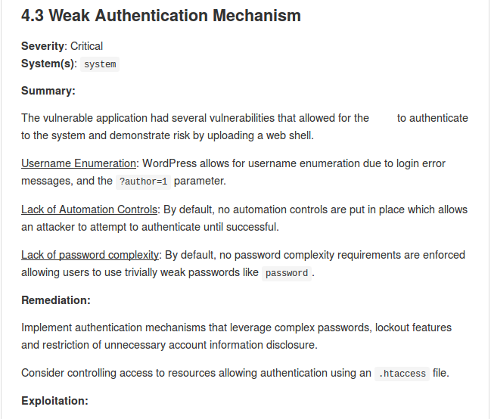
Reporting
We leverage Markdown for custom reporting, which uses an HTML-esque format. Common Findings Database - Check it out
Some customers also enjoy having a spreadsheet of findings in addition to the report.
Find out the format your customer prefers/needs.

Slide 49
Reporting (Cont.)
Depending on your Rules of Engagement (ROE), consider this:
If you find a vulnerability or flaw within a system and you do exploit it then include an exploitation section with to your finding.
If you find a vulnerability or flaw within a system and you could exploit it then include an attacker scenario section within your finding
Also:
Pics or it didn’t happen (always include screenshots!)
Include detailed steps taken to identify the vulnerability if done via manual testing (OSINT, fuzzing, dirbuster, etc.)
Include a high level summary for each finding to appeal to managers before going too deep into the technical details

Slide 50


Offer Remediation Testing
Offering remediation support to your customers after delivering the report is like kicking the extra point after winning the game scoring touchdown
Re-evaluating findings once they are deemed mitigated or resolved
When possible, provide additional remediation recommendations and countermeasures beyond what’s state in the report
Can lead to additional testing and a stronger relationship with the customer

Slide 51

Useful Trainings & Links
Free Training: Cybrary
CTFs: Vulnhub, Past CTF Writeups, Pentester Lab
Training: Offensive Security, GWAPT
Book: Web Application Hackers Handbook
Book: Black Hat Python
Talk: How to Shot Web - Jason Haddix
Talk: How to be an InfoSec Geek - Primal Security
Talk: File in the hole! - Soroush Dalili
Talk: Exploiting Deserialization Vulnerabilities in Java
Talk: Polyglot Payloads in Practice - Marcus Niemietz
Talk: Running Away From Security - Micah Hoffman
Github Resource: Security Lists For Fun & Profit

Slide 52

Contact Us
Site: https://www.breakpoint-labs.com
Email: info@breakpoint-labs.com
Twitter: @0xcc_labs

